Slide 1

Search Engine Relevance for Video Subtitles

Slide 2
About me
I am Meghana Rampally . I have completed my M.Sc-Mathematics in 2023.
I'm drawn to data science for its dynamic blend of analytical rigor and creative problem-solving. In today's data-rich world, I see data science as a gateway to unlocking the untapped potential hidden within vast datasets. By harnessing the power of data science, I'm equipped to derive meaningful insights, identify patterns, and make informed decisions that drive tangible impact.
Ultimately, my choice to pursue data science stems from a deep-seated belief in its transformative potential to revolutionize industries, improve lives, and shape the future.
LinkedIn profile: https://www.linkedin.com/in/meghana-rampally
GitHub profile: https://github.com/meghana9904

Slide 3
Background: In the fast-evolving landscape of digital content, effective search engines play a pivotal role in connecting users with relevant information. For Google, providing a seamless and accurate search experience is paramount. This project focuses on improving the search relevance for video subtitles, enhancing the accessibility of video content.
Objective
Develop an advanced search engine algorithm that efficiently retrieves subtitles based on user queries, with a specific emphasis on subtitle content. The primary goal is to leverage natural language processing and machine learning techniques to enhance the relevance and accuracy of search results.

Slide 4
Types Of Search Engines That Can Be Build: Keyword based vs Semantic Search Engines: Keyword Based Search Engine: These search engines rely heavily on exact keyword matches between the user query and the indexed documents. Semantic Search Engines: Semantic search engines go beyond simple keyword matching to understand the meaning and context of user queries and documents. Comparison: While keyword-based search engines focus primarily on matching exact keywords in documents, semantic-based search engines aim to understand the deeper meaning and context of user queries to deliver more relevant and meaningful search results.

Slide 5
About Data:
Database contains a sample of 82498 subtitle files from opensubtitles.org.
Most of the subtitles are of movies and tv-series which were released after 1990 and before 2024.
Database File Name: eng_subtitles_database.db
Database contains a table called 'zipfiles' with three columns. 1. num: Unique Subtitle ID reference for www.opensubtitles.org 2. name: Subtitle File Name 3. content: Subtitle file were compressed and stored as a binary using 'latin-1' encoding.
You can use 'num' to get more details about each subtitle by going to the following link: https://www.opensubtitles.org/en/subtitles/{num} **Replace {num} with Unique Subtitle ID.

Slide 6
Process Of Building Search Engine:
Part-1
Retrieving data from database: The database contains the subtitles files in .srt format so I loaded the SQLite to access the database and loaded the files with encoding.
Loading data: As the database contain large data I used randomly 30% of data because of limited computational resource.
Preprocessing the data:
1. Converting the subtitles to lowercase.
2. Removing the timestamps.
3. Removing the special characters.
4. Removing the HTML Tags.
5.Removing the URLs.
Document chunking: As the data is large creating of chunks make the task more easy to perform and also the chunking should be semantic to preserve context.

Slide 7
5. Vectorization: The most important step is to convert the text to vectors.
1.TFIDF vectorizer: I performed the TFIDF vectorizer where this helps to build the Keyword based search engine .
2. BERT model: This BERT model is used to build the semantic search engine.
I performed both the vectorizations and finally used the BERT model to build the Semantic Search Engine.
6. Storing of Embeddings: The embeddings are to be stored in the ChromaDB database.
Part-2
1.Users query: Take the user's search query.
2. Preprocess the query: Preprocessing the users search query which involves the step of preprocessing the data.
3. Create query embedding: Converting the text to vector by trained model.
4.Using cosine similarity: Calculate the similarity score between embeddings of documents and user search query embedding.
5. Retrieving relevant document: These cosine similarity scores will help in returning the most relevant candidate documents as per user’s search query.

Slide 8
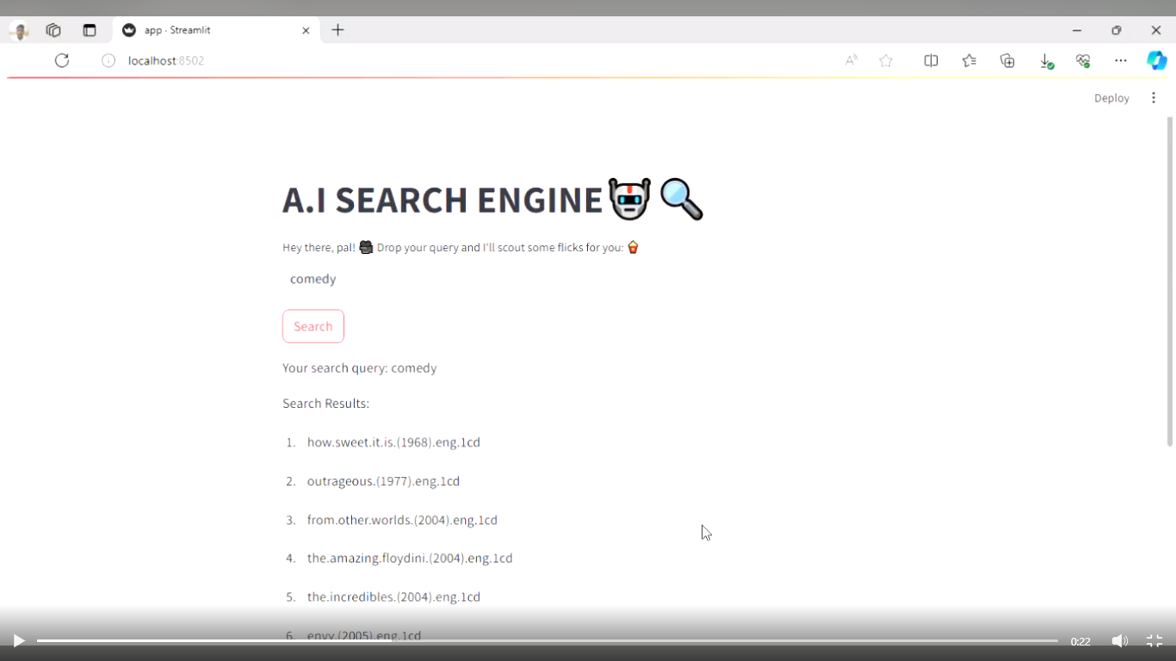
FINAL STEP:
Created the flask Application of Semantic Search Engine which takes the users query and retrieves the similar documents of movie subtitles.

Slide 9

THANK YOU

